Slide 1
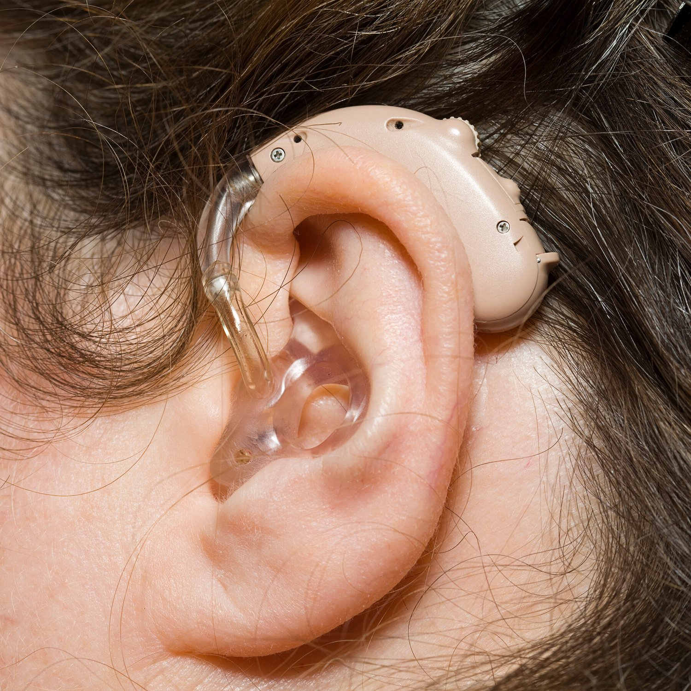
HEARING AID
Prepared By
Ms. G. Sudhanthira (AP/BME)

Slide 2
HEARING AID
Hearing aids are small electronic devices designed to improve hearing by amplifying sound. They are typically worn in or behind the ear and help individuals with hearing loss to better perceive sounds, especially speech, by making it louder and clearer.
Principle of Hearing Aids
The basic principle of hearing aids is sound amplification. They capture environmental sounds using a microphone, process the sound by amplifying specific frequencies (based on the wearer’s hearing loss), and then deliver the amplified sound into the ear canal through a speaker or receiver.
Key Components of a Analog (or conventional)Hearing Aid:
Microphone: Captures sound from the environment.
Amplifier: Increases the strength of the sound signals.
Receiver/Speaker: Converts the amplified electrical signals back into sound waves and sends them into the ear.
Battery: Provides power to the hearing aid.

Slide 3
Working Principle of Analog Hearing Aids
Sound Capture (Microphone)
The process begins with the microphone picking up the sound waves from the surrounding environment. These sound waves, which consist of both speech and background noise, are converted into electrical signals by the microphone.
Amplification (Amplifier)
The electrical signals are sent to the amplifier, which increases the strength of the signals. In analog hearing aids, all the captured sounds (both desired sounds like speech and undesired sounds like background noise) are amplified equally. There is no filtering or separation of different types of sounds.
The degree of amplification is set manually by the audiologist or user, typically through a volume control.
Conversion Back to Sound (Receiver/Speaker)
After amplification, the electrical signals are converted back into sound waves by the receiver (also called the speaker). These sound waves are then delivered into the ear canal for the user to hear.
Since analog hearing aids amplify all sounds equally, both speech and environmental noise are made louder. This can sometimes make it difficult for users to distinguish between important sounds (like speech) and unwanted noise (like wind or background chatter).
Output to Ear Canal
The amplified sound enters the ear canal, where it is received by the user’s ear, helping them hear sounds that would otherwise be too soft to detect.

Slide 4
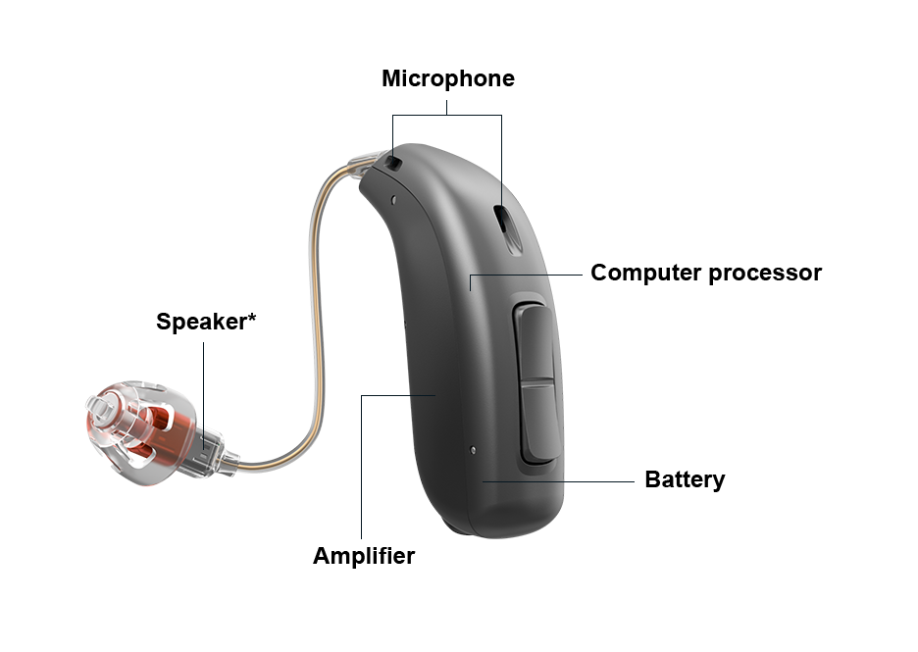

Slide 5
Drawback in Conventional Hearing Aids
Conventional hearing aids, while effective for many, have several limitations that can affect their performance and user experience. These drawbacks primarily stem from older technology, lack of customization, and difficulties in specific listening environments.
1. Lack of Customization
Conventional hearing aids often amplify all sounds equally, without focusing on specific frequencies or filtering out noise. This can lead to:
Amplification of Unwanted Noise: Environmental noises, such as background chatter, traffic, or wind, are amplified along with speech, making it difficult for users to focus on important sounds.
Inability to Adjust to Different Listening Environments: Conventional hearing aids cannot automatically adapt to various sound environments (e.g., quiet rooms vs. noisy restaurants), leading to an inconsistent listening experience.

Slide 6
Drawback in Conventional Hearing Aids
2. Limited Frequency Range
Generalized Amplification: Traditional hearing aids amplify all sound frequencies across the board. This can be problematic for users with high-frequency hearing loss (e.g., difficulty hearing consonants like "s" or "t". Without specialized tuning, all frequencies, including low ones (which the user may not need amplified), are boosted, making sounds less natural.
Speech Clarity Issues: The inability to target specific frequencies may lead to poor speech comprehension, especially in challenging environments like crowded places.
3. Feedback and Whistling
Feedback Noise: Conventional hearing aids are prone to feedback, which occurs when the microphone picks up sound from the speaker and creates a loop of sound. This results in a high-pitched whistling or squealing noise that can be uncomfortable and embarrassing for users.
Sensitive to Movement: Simple actions, like putting a hand near the ear or wearing a hat, can cause feedback noise.

Slide 7
Drawback in Conventional Hearing Aids
4. Limited or No Noise Reduction
Background Noise Sensitivity: Conventional hearing aids lack advanced noise reduction features. In noisy environments, all sounds are amplified, which can make conversations difficult to follow.
No Directional Microphones: Older hearing aids typically lack directional microphones, which help users focus on sounds coming from specific directions (like a person talking in front of them), further complicating hearing in noisy situations.
5. Bulky Design
Visibility: Traditional hearing aids, especially the Behind-the-Ear (BTE) models, are often large and visible. Many users feel self-conscious wearing them, especially younger individuals who may be concerned about aesthetics.
Physical Discomfort: The bulkier design of some conventional models may cause discomfort when worn for long periods. They may also interfere with eyeglasses or masks, leading to irritation or difficulty in wearing multiple accessories.

Slide 8
Drawback in Conventional Hearing Aids
6. Manual Controls
No Automatic Adjustments: Conventional hearing aids often require manual adjustments for volume control, making them less user-friendly. This is especially inconvenient for elderly users or those with dexterity issues.
Difficulty Switching Modes: Many older models do not automatically adjust between different sound environments, such as switching from quiet to noisy places. Users have to manually switch between different programs, which can be inconvenient.
7. Short Battery Life
Frequent Battery Changes: Conventional hearing aids, especially smaller models, require frequent battery replacements, which can be both expensive and inconvenient. Battery life is generally shorter, leading to the need for constant monitoring of battery levels.
Inconvenient for Older Adults: People with limited dexterity or poor vision, such as older adults, may find it difficult to replace batteries on a regular basis.

Slide 9
Drawback in Conventional Hearing Aids
8. Limited Connectivity
No Wireless Features: Older hearing aids do not support wireless connectivity to devices like smartphones, TVs, or music players. Users may find it difficult to interact with modern technology or enjoy multimedia experiences without removing the hearing aids or using separate assistive listening devices.
No App Integration: Conventional models lack the ability to be customized through mobile apps or remote controls. This limits the flexibility of adjusting settings for personal preferences without visiting an audiologist.
9. Susceptibility to Moisture and Earwax
Damage from Moisture and Earwax: Conventional hearing aids are more prone to damage from earwax buildup and moisture, which can clog the device or cause malfunctions. This can lead to frequent repairs and maintenance.
Shorter Lifespan: The lack of moisture and dust resistance in older models reduces their longevity and increases the need for replacement or repair.

Slide 10
Drawback in Conventional Hearing Aids
Limited Frequency of Use and Social Impact
Discomfort in Loud Environments: Conventional hearing aids may amplify sound excessively in environments with sudden loud noises (e.g., restaurants, concerts), leading to discomfort and forcing users to turn off the device or lower the volume, thereby missing important sounds.
Social Stigma: Due to their visible and often large designs, older hearing aids can contribute to a stigma associated with aging or disability, making users feel self-conscious or embarrassed.

Slide 11
DSP Based Hearing Loss
DSP (Digital Signal Processing)-based hearing aids represent a significant advancement in hearing technology over traditional analog hearing aids. Digital Signal Processing (DSP) enables hearing aids to process sound more precisely and offer a personalized hearing experience. DSP-based hearing aids convert sound into digital signals, apply sophisticated algorithms to enhance the sound, and then convert it back into an analog signal that is delivered to the ear. This advanced approach allows for much better sound quality, clarity, and adaptability to different listening environments.

Slide 12
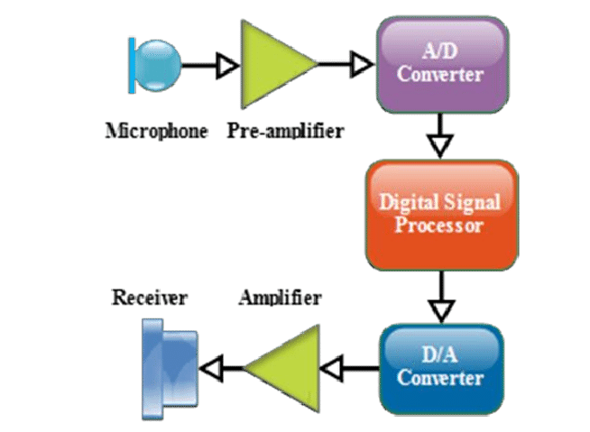

Slide 13
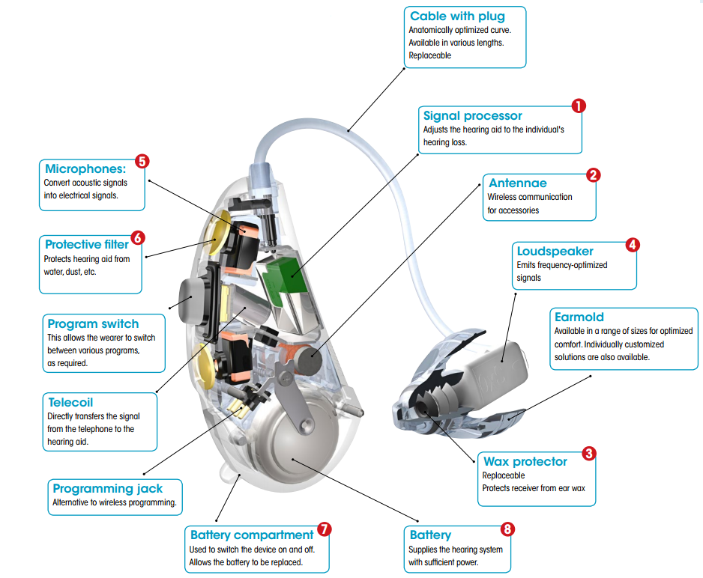

Slide 14
Working Principle of DSP in Hearing Aids
Sound Capture (Microphone)
The hearing aid’s microphone picks up sound from the surrounding environment, converting the analog sound waves into digital signals.
Digital Signal Processing (DSP Unit)
The DSP processor inside the hearing aid analyzes and processes the digital sound signals. This process includes:
Filtering out noise: DSP identifies unwanted noise and reduces it.
Amplifying specific frequencies: Based on the user’s hearing loss profile, DSP selectively amplifies frequencies that the user has trouble hearing.
Speech enhancement: Advanced algorithms detect speech and enhance clarity while reducing background noise.
Signal Conversion (Amplifier and Receiver)
Once the sound is processed, it is converted back into analog signals, amplified, and sent to the hearing aid’s speaker (receiver), which delivers the sound into the ear canal.
Feedback Detection and Cancellation
The DSP processor continuously monitors for any feedback (whistling or squealing sounds) and cancels it out by adjusting the amplification in real-time.
Output to Ear Canal
The processed, amplified, and feedback-free sound reaches the ear canal, providing clear, customized sound that suits the user’s specific hearing needs.

Slide 15
Key Features and Advantages of DSP-Based Hearing Aids
Sound Customization and Precision
Frequency-Specific Amplification: DSP-based hearing aids can amplify specific frequencies that the user has difficulty hearing. For example, high-frequency sounds (like birds chirping or consonant sounds in speech) can be selectively amplified while lower frequencies are adjusted independently.
Noise Filtering: DSP technology can separate speech from background noise, allowing for better understanding in noisy environments. This is particularly helpful for people who struggle to follow conversations in restaurants, social gatherings, or other noisy situations.
Automatic Adjustment to Environments
Adaptive Sound Processing: DSP-based hearing aids can automatically adjust to different listening environments. For example, they can enhance speech in quiet settings and reduce noise in loud environments without requiring manual input from the user.
Multiple Listening Modes: These hearing aids can switch between various presets for different environments (e.g., "outdoor," "crowded room," "music") and optimize sound processing accordingly.

Slide 16
Key Features and Advantages of DSP-Based Hearing Aids
Feedback Cancellation
Real-Time Feedback Suppression: DSP technology can detect and eliminate feedback (the high-pitched whistling noise common in traditional hearing aids) in real time, making the hearing experience more comfortable.
Dynamic Feedback Control: The hearing aids can adjust for changes in feedback caused by physical objects like phones, hats, or hands near the ear.
Directional Microphones and Beamforming
Directional Sound Capture: DSP-based hearing aids often include directional microphones that focus on sounds coming from a specific direction (e.g., someone speaking directly in front of the user) while reducing background noise from other directions.
Beamforming: This technology further enhances sound from a particular direction, helping to focus on desired sounds like speech while ignoring noise from the sides or behind the listener.

Slide 17
Key Features and Advantages of DSP-Based Hearing Aids
Advanced Noise Reduction
Dynamic Noise Filtering: DSP hearing aids can identify and reduce unwanted noise (e.g., wind, traffic, or machinery) while keeping the important sounds, such as speech, intact. This enhances listening comfort in challenging environments.
Background Noise Differentiation: The hearing aid can distinguish between types of noise and adjust accordingly, providing a more balanced hearing experience.
Data Logging and Learning
Personalization through Machine Learning: Some DSP-based hearing aids can learn from the user’s behavior and listening preferences over time. They can record how often certain environments or settings are used and adjust the sound accordingly to offer a more personalized experience.
Data Logging for Audiologists: These devices can store data about how the hearing aid is used, allowing audiologists to fine-tune the settings based on real-world usage patterns.

Slide 18
Key Features and Advantages of DSP-Based Hearing Aids
Wireless Connectivity and Smart Features
Bluetooth Integration: Many DSP hearing aids offer Bluetooth connectivity, allowing users to stream audio directly from smartphones, TVs, or other devices. This feature is especially useful for phone calls, music, and watching TV.
App Control: Users can adjust their hearing aids via smartphone apps, allowing for real-time modifications to settings like volume, sound balance, and listening modes without having to visit an audiologist.
Rechargeable Options: DSP hearing aids often come with rechargeable batteries, eliminating the need for constant battery changes.

Slide 19
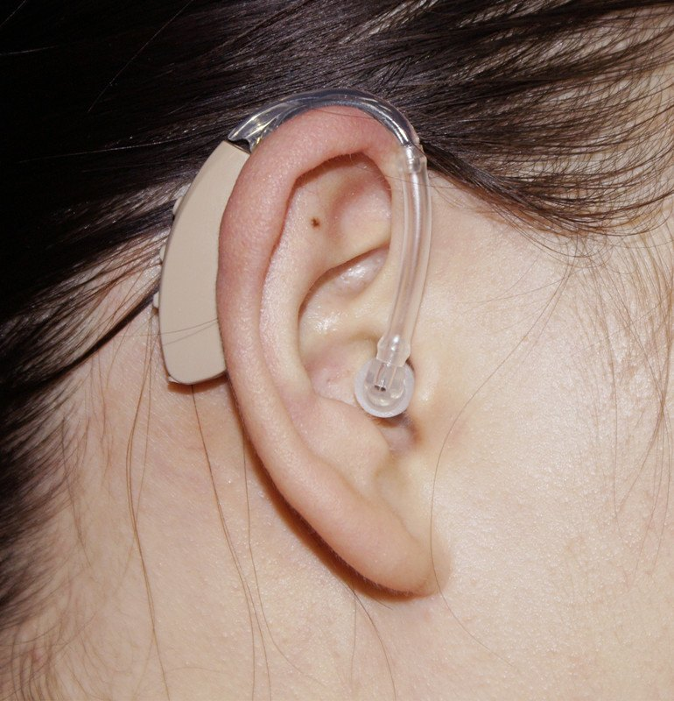
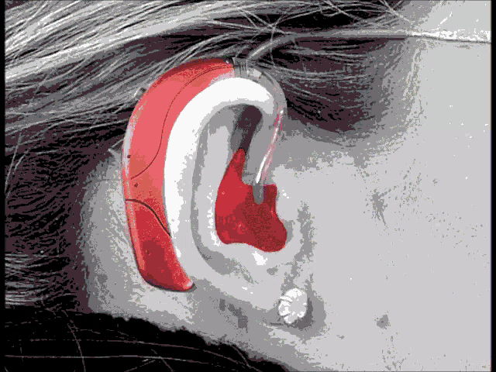
Types of Hearing Aids
Hearing aids are categorized based on their size, placement in or on the ear, and functionality:
Behind-the-Ear (BTE):
Design: Worn behind the ear with a tube connecting the hearing aid to an earmold or earpiece inside the ear canal.
Advantages: Suitable for all types of hearing loss, especially severe to profound hearing loss. Larger size allows for more features like stronger amplification and longer battery life.
Disadvantages: Visible, potentially bulky for some users.

Slide 20
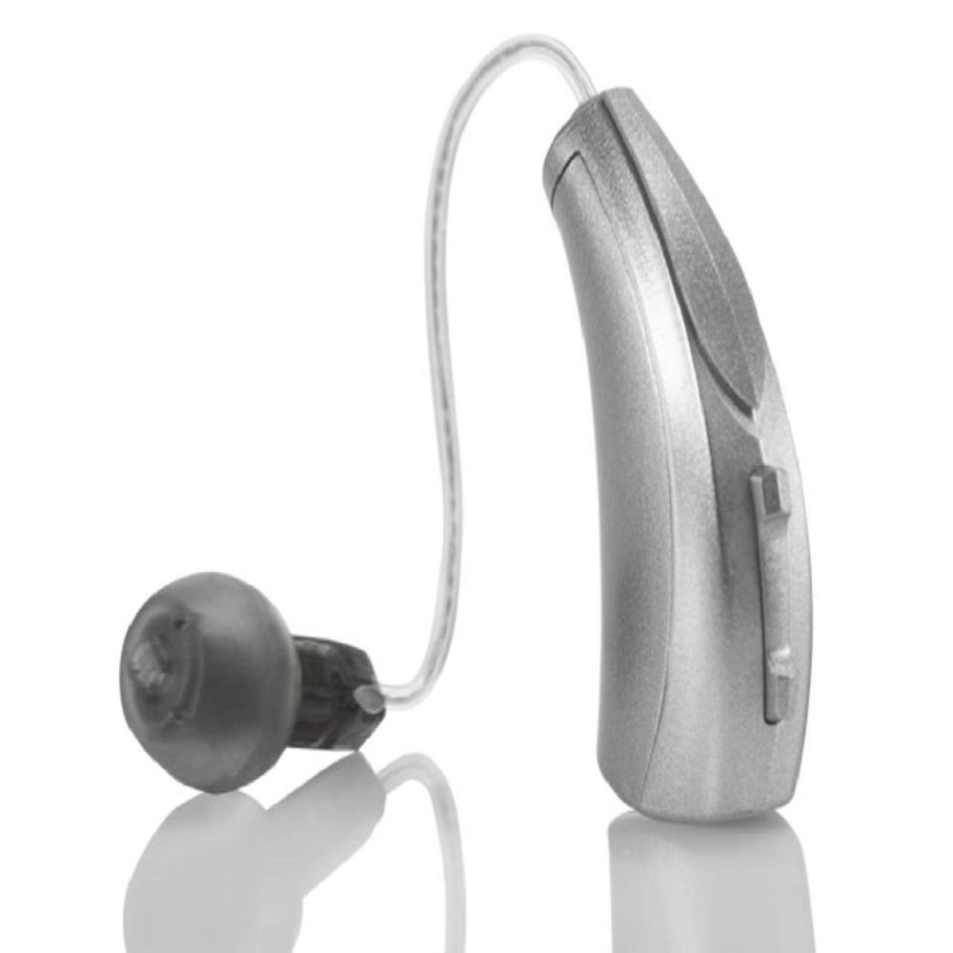
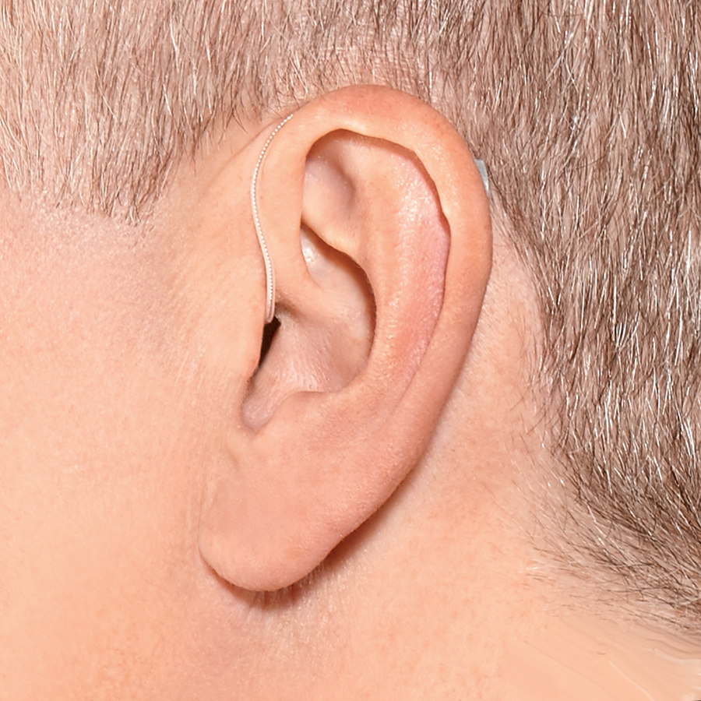
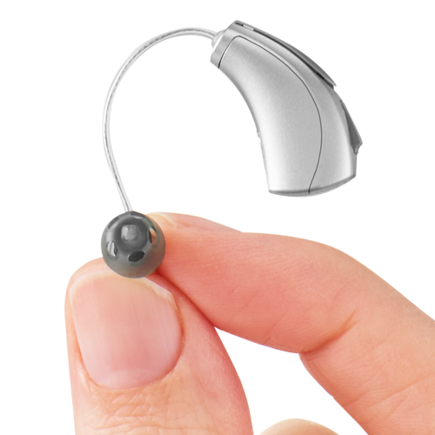
Types of Hearing Aids
Receiver-in-Canal (RIC) / Receiver-in-the-Ear (RITE):
Design: Similar to BTE, but the receiver (speaker) is placed in the ear canal, connected by a thin wire.
Advantages: Less visible than BTE, offers more natural sound quality.
Disadvantages: May not be as powerful as BTE, less suitable for profound hearing loss.

Slide 21
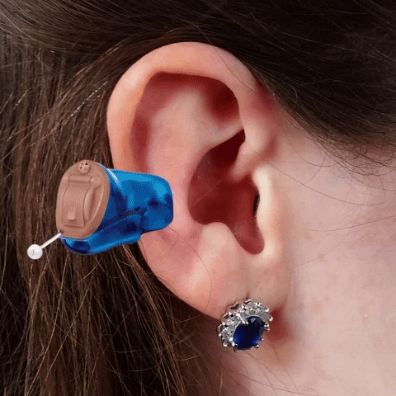
Types of Hearing Aids
In-the-Ear (ITE):
Design: Fits completely inside the outer ear. All components are contained in a custom-molded shell.
Advantages: Less visible than BTE, suitable for mild to moderate hearing loss.
Disadvantages: May be affected by earwax or moisture, limited battery life and features due to size.

Slide 22
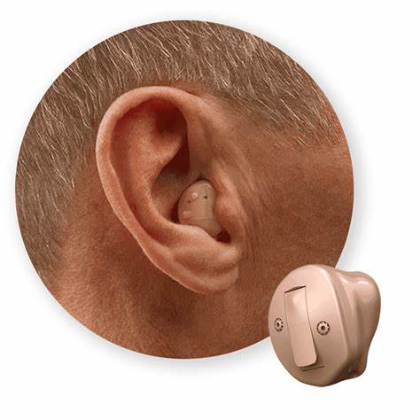
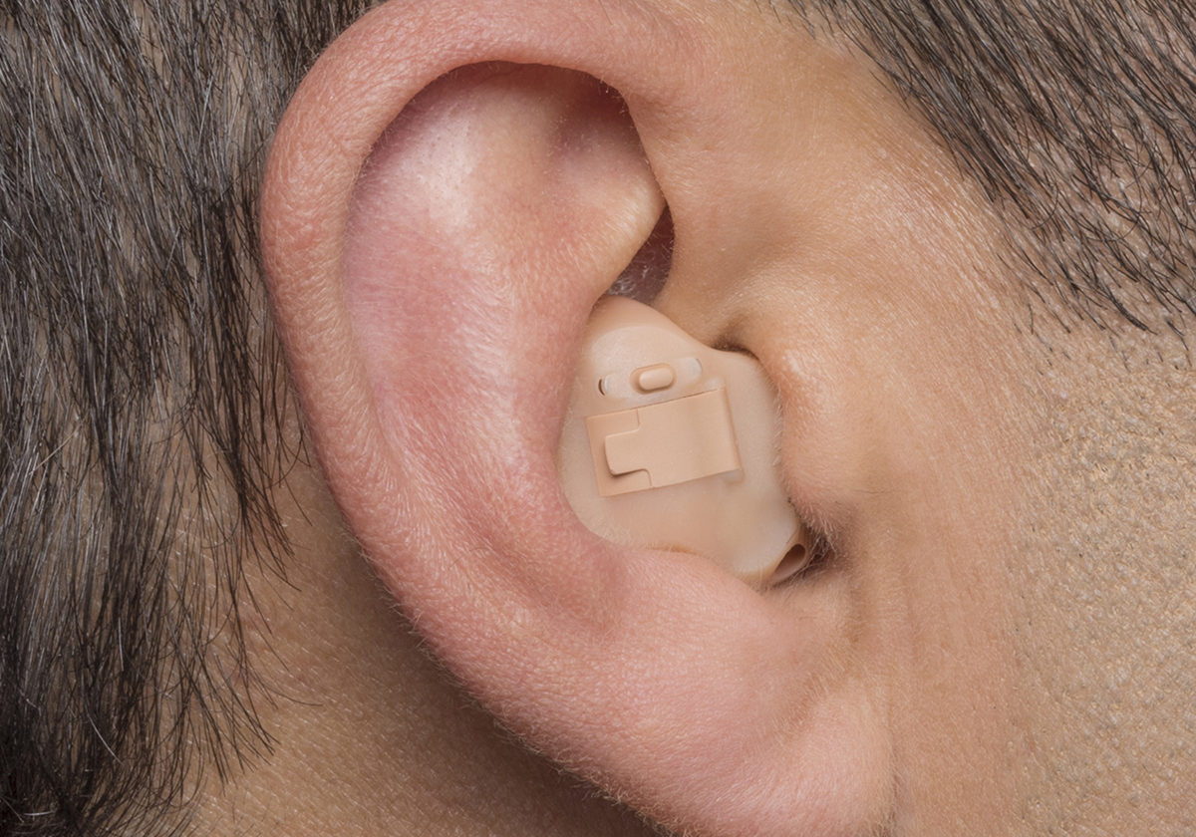
Types of Hearing Aids
In-the-Canal (ITC):
Design: Fits partly into the ear canal. Smaller than ITE but still visible in the outer ear.
Advantages: More discreet than ITE and BTE, suitable for mild to moderate hearing loss.
Disadvantages: Can be difficult to handle due to small size, not suitable for severe hearing loss.

Slide 23
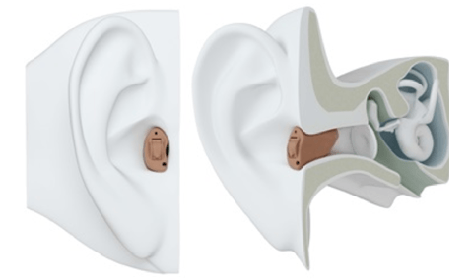
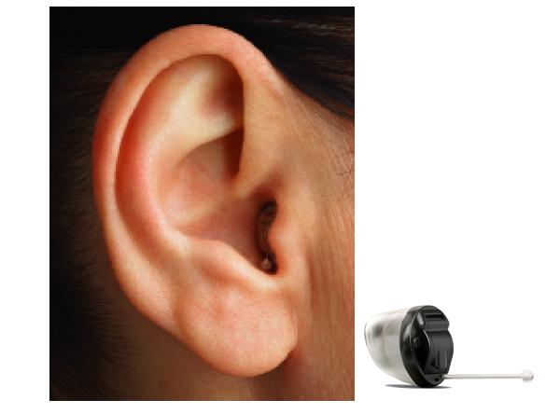
Types of Hearing Aids
Completely-in-Canal (CIC) and Invisible-in-Canal (IIC):
Design: Fits entirely within the ear canal (CIC) or deeper in the canal (IIC), making them nearly or completely invisible.
Advantages: Most discreet, highly cosmetic.
Disadvantages: Limited features and power due to small size, shorter battery life, susceptible to earwax buildu

Slide 24
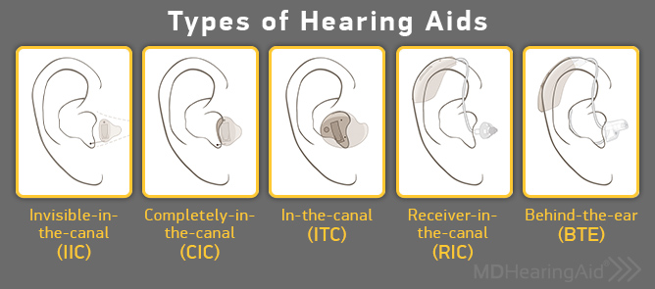

Slide 25
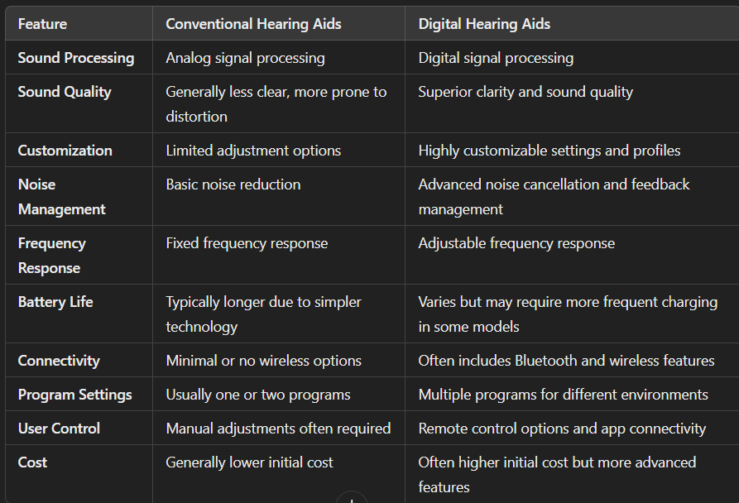

Slide 26
Surgical Hearing Aids
Implantable devices designed to improve hearing for individual.
Surgically placed inside or near the ear
Candidacy: Sensorineural hearing loss, Neuro fibromatosis2 etc.
Types:
Cochlear Implants
Bone-Anchored Hearing Aids (BAHA) or Bone Conduction Implants
Middle Ear Implants (MEI)
Auditory Brainstem Implants (ABI)

Slide 27
Cochlear Implants (CI)
Purpose:
Cochlear implants are designed for individuals with severe to profound sensorineural hearing loss, meaning their inner ear (cochlea) is too damaged to process sound properly. Unlike traditional hearing aids, which amplify sound, cochlear implants bypass damaged hair cells in the cochlea and directly stimulate the auditory nerve.
Who Can Benefit?
Individuals with severe to profound sensorineural hearing loss in one or both ears.
People who do not benefit from traditional hearing aids.
Children as young as 12 months old can receive a cochlear implant.

Slide 28
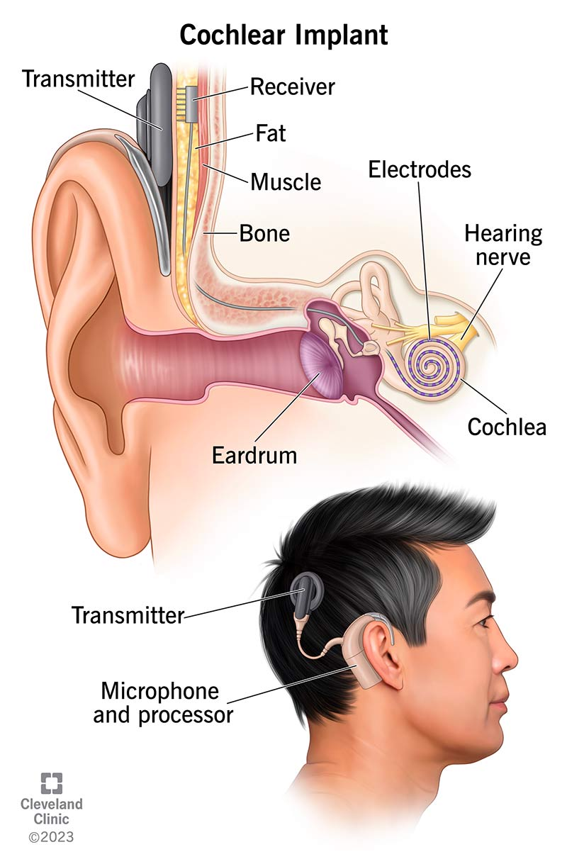
Cochlear Implants (CI)

